Slide 1

Network Programming
SPG 0463
AMNI SAIZAN

Slide 2
Chapter 2:
Introduction to Python

Slide 3
Introduction to Python
Subtopics
The Python language
Standard Libraries and Extension Modules
Installation
Python Development environment
Running Python Programs
Python Interpreter
PRACTICAL :
  Getting Python up and running it.
  Program and run a simple Python program

Slide 4
The Python language
Interpreted, interactive, object-oriented programming language.
Incorporates modules, exceptions, dynamic typing, data types and classes.
Can be run on Unix, Mac and Windows

Slide 5
Installation
Use vbox.
Install fedora in vbox.
Then install python.

Slide 6
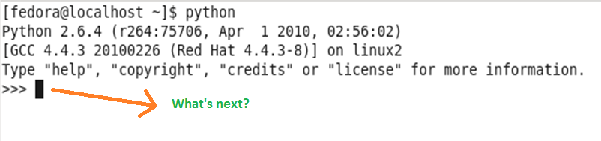
Talking to Python

Slide 7
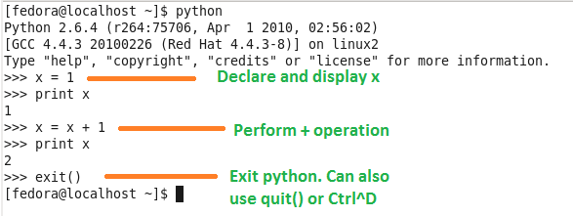
Talking to Python(cont’d)
Good test to make sure the python works correctly.
To end the interactive session, can use exit(), quit() and Ctrl^D

Slide 8
What do we say?
  Elements of python
  Programming paragraphs

Slide 9
Elements of python
  Vocabulary / Words
    Variables and reserved words
  Sentence structure
    Valid syntax patterns
  Story structure
    Construct a program for a purpose

Slide 10
A short “Story” about how to count words in a file in Python.
name = raw_input('Enter file:')
handle = open(name, 'r')
text = handle.read()
words = text.split()
counts = dict()
for word in words:
counts[word] = counts.get(word,0) + 1
bigcount = None
bigword = None
for word,count in counts.items():
if bigcount is None or count > bigcount:
bigword = word
bigcount = count
print bigword, bigcount
python words.py
Enter file: words.txt
to 16

Slide 11
Reserved Words
You can not use reserved words as variable names / identifiers
and del for is raise assert elif from lambda return break else global not try class except if or while continue exec import pass yield def ﬁnally in print

Slide 12
Sentences or Lines
x = 2
x = x + 2
print x
Assignment Statement
Assignment with expression
Print statement
Variable
Operator
Constant
Reserved Word

Slide 13
Programming Paragraphs

Slide 14
Writing a Simple Program

Slide 15
Interactive versus Script
Interactive
  You type directly to Python one line at a time and it responds
Script
  You enter a sequence of statements (lines) into a file using a text editor and tell Python to execute the statements in the file

Slide 16
Python Scripts
Interactive Python is good for experiments and programs of 3-4 lines long
But most programs are much longer so we type them into a file and tell python to run the commands in the file.
In a sense we are “giving Python a script”
As convention, we add “.py” as the suffix on the end of these files to indicate they contain Python

Slide 17
Program Steps or Program Flow
Like a recipe or installation instructions, a program is a sequence of steps to be done in order
Some steps are conditional - they may be skipped
Sometimes a step or group of steps are to be repeated
Sometimes we store a set of steps to be used over and over as needed several places throughout the program.

Slide 18
Sequential Steps
Program:
x = 2
print x
x = x + 2
print x
x = 1
Output:
2
4
print x
x = x + 1
print x
When a program is running, it flows from one step to the next. We as programmers set up “paths” for the program to follow.

Slide 19
Conditional Steps
x = 5
X < 10 ?
Yes
Program:
x = 5
if x < 10:
print 'Smaller’
if x > 20:
print 'Bigger'
print 'Finis'
print 'Smaller'
Output:
Smaller
Finis
X > 20 ?
Yes
print 'Bigger'
print 'Finis'

Slide 20
Repeated Steps
n = 5
Program:
n = 5
while n > 0 :
print n
n = n – 1
print 'Blastoff!'
No
n > 0 ?
Yes
Output:
5
4
3
2
1
Blastoff!
print n
n = n -1
print 'Blastoff'
Loops (repeated steps) have iteration variables that change each time through a loop. Often these iteration variables go through a sequence of numbers.

Slide 21
Variables, expression & statements

Slide 22
Constants
Fixed values such as numbers, letters, and strings are called “constants” - because their value does not change
Numeric constants are as you expect
String constants use single-quotes (')
or double-quotes (")
>>> print 123
123
>>> print 98.6
98.6
>>> print 'Hello world'
Hello world

Slide 23
Variables
A variable is a named place in the memory where a programmer can store data and later retrieve the data using the variable “name”
Programmers get to choose the names of the variables
You can change the contents of a variable in a later statement
x = 12.2
y = 14
x = 100

Slide 24
Python Variable Name Rules
Must start with a letter or underscore _
Must consist of letters and numbers and underscores
Case Sensitive
Good: spam eggs spam23 _speed
Bad: 23spam #sign var.12
Different: spam Spam SPAM

Slide 25
Reserved Words
You can not use reserved words as variable names / identifiers
and del for is raise
assert elif from lambda return
break else global not try
class except if or while
continue exec import pass yield
def ﬁnally in print

Slide 26
Sentences or Lines
x = 2
x = x + 2
print x
Assignment Statement
Assignment with expression
Print statement
Variable
Operator
Constant
Reserved Word

Slide 27

Assignment Statements
We assign a value to a variable using the assignment statement (=)
An assignment statement consists of an expression on the right hand side and a variable to store the result
x = 3.9 * x * ( 1 - x )

Slide 28
Operator precedence
This operator precedence starts from the highest precedence rules:
  Parenthesis
  Power
  Multiplication
  Addition
  Left to Right

Slide 29

Get input from user

Slide 30
You should be able to:
  Perform installation for Python.
  Familiarize with Python development environment.
  Familiarize with basic python syntax.

Slide 31
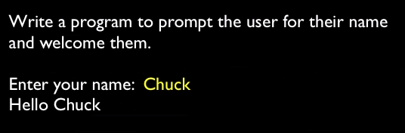
Task 1

Slide 32
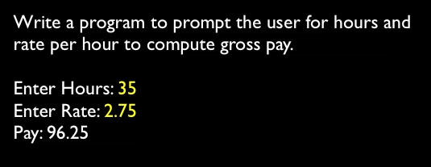
Task 2
Pay = hours * rate

Slide 33
Task 3
How old are you? 38
How tall are you? 160
How much do you weigh? 60
So, you’re 38 old, 160 tall and 60 heavy

Slide 34
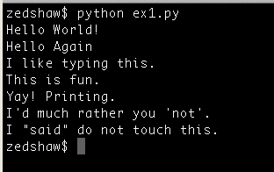
Task 4

Slide 35
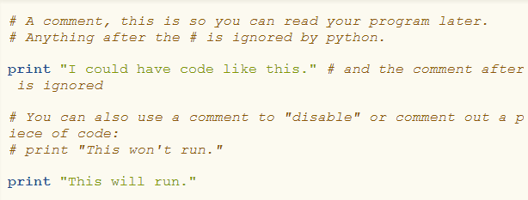
Task 5

